Slide 1
Servlet Database Connectivity

Slide 2
Servlet Life cycle
A servlet life cycle can be defined as the entire process from its creation till the destruction.
init ()
servlet is initialized
service()
to process a client's request.
destroy()
servlet is terminated
Finally, servlet is garbage collected by the garbage collector of the JVM.

Slide 3
Init() method
The init method is designed to be called only once
It is called when the servlet is first created, and not called again for each user request
The servlet is normally created when a user first invokes a URL corresponding to the servlet
init() method simply creates or loads some data that will be used throughout the life of the servlet
init() method definition looks like as follows
public void init() throws ServletException
{ // Initialization code... }

Slide 4
Service() method
The service()
performs the actual task
Servlet container (i.e. web server)
calls the service() method to handle requests coming from the client( browsers) and
writes the formatted response back to the client.
each time the server receives a request for a servlet, the server spawns a new thread and calls service
The service() method
checks the HTTP request type (GET, POST, PUT, DELETE, etc.)
calls doGet, doPost, doPut, doDelete, etc. methods as appropriate.
service() method definition looks like as follows
public void service(ServletRequest request, ServletResponse response) throws ServletException, IOException
{
public void doGet(HttpServletRequest request, HttpServletResponse response) throws ServletException, IOException { // Servlet code }
- - - -
}

Slide 5
Destroy() method
destroy() method
called only once at the end of the life cycle of a servlet
gives your servlet a chance
to close database connections
halt background threads
write cookie lists or hit counts to disk
perform other such cleanup activities.

Slide 6
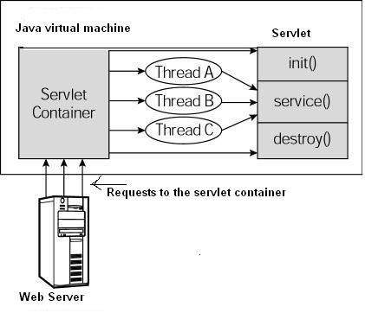
Servlet life-cycle scenario
HTTP requests coming to the server are delegated to the servlet container.
The servlet container loads the servlet before invoking the service() method.
Servlet container handles multiple requests by spawning multiple threads
each thread executing the service() method of a single instance of the servlet

Slide 7
Servlet – Database Connectivity
A Java Database Connectivity (JDBC) driver is a software component enabling a Java application to interact with a database
JDBC helps you to write Java applications that manage these three programming activities:
Connect to a data source, like a database
Send queries and update statements to the database
Retrieve and process the results received from the database in answer to your query

Slide 8
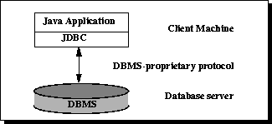
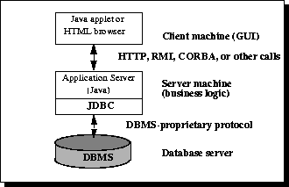
Database Access Models

Slide 9
MySql Installation
Use mysql-5.5.30-win32 to install mysql
While installing, provide user name and password
Copy the mysql-connector-java-3.1.14-bin to “C:\Program Files\Apache Software Foundation\Tomcat 7.0\lib”
To run mysql go to Start→ All Program→ MySqL→ MySql5.5 Command Line Client and double click it

Slide 10
Creation of table
Provide password “ ”
Use the default database as follows
mysql> use TEST;
mysql> create table Employees
(
id int not null,
age int not null,
first varchar (255),
last varchar (255)
);
Insert new rows as follows
INSERT INTO Employees VALUES (100, 18, 'Zara', 'Ali');

Slide 11
Java code snippet to access database
public void doGet(HttpServletRequest request,
HttpServletResponse response)
throws ServletException, IOException
{
// JDBC driver name and database URL
final String JDBC_DRIVER="com.mysql.jdbc.Driver";
final String DB_URL="jdbc:mysql://localhost:3306/TEST";
// Database credentials
final String USER = "";
final String PASS = “";

Slide 12
...Contd
Connection conn = null;
Statement stmt = null;
// Set response content type
response.setContentType("text/html");
PrintWriter out = response.getWriter();
String title = "Database Result";
// Register JDBC driver
Class.forName("com.mysql.jdbc.Driver");
// Open a connection
conn = DriverManager.getConnection(DB_URL,USER,PASS);

Slide 13
...Contd
// Execute SQL query
stmt = conn.createStatement();
String sql;
sql = "SELECT id, first, last, age FROM Employees";
ResultSet rs = stmt.executeQuery(sql);
while(rs.next()){
//Retrieve by column name
int id = rs.getInt("id");
int age = rs.getInt("age");
String first = rs.getString("first");
String last = rs.getString("last");

Slide 14
...Contd
//Display values
out.println("ID: " + id + "<br>");
out.println(", Age: " + age + "<br>");
out.println(", First: " + first + "<br>");
out.println(", Last: " + last + "<br>");
}
out.println("</body></html>");
// Clean-up environment
rs.close();
stmt.close();
conn.close();

Slide 15
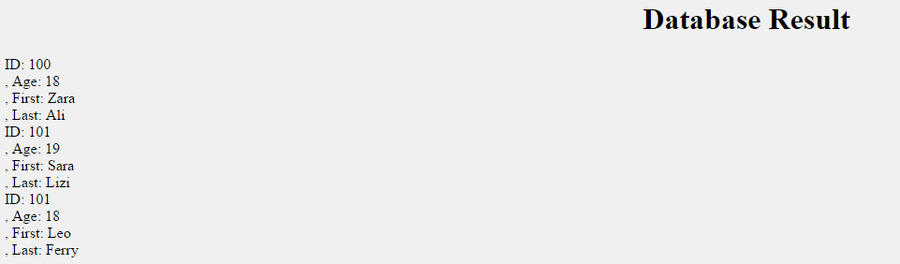
Output
Navigate to http://localhost:8080

